Slide 1
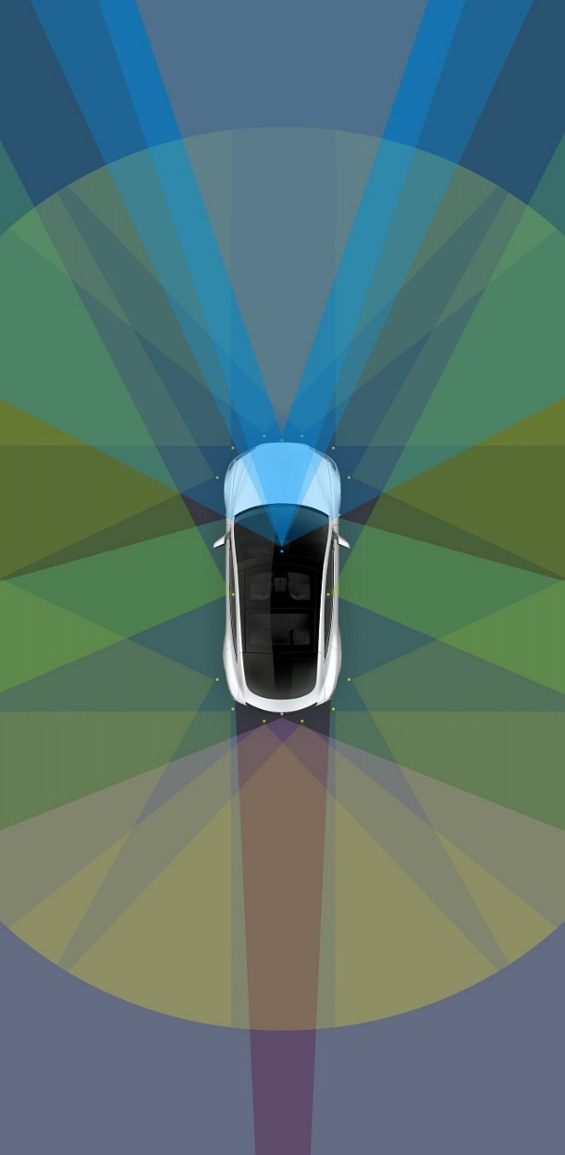
Improved Markov random field in
reconstructing super-resolution depth images
Team Member：童年、黄珂邈

Slide 2

1.Background and Related Work
2.System Architecture
Contents
3.Expected Result
4.Timeline

Slide 3
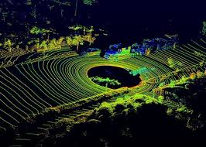
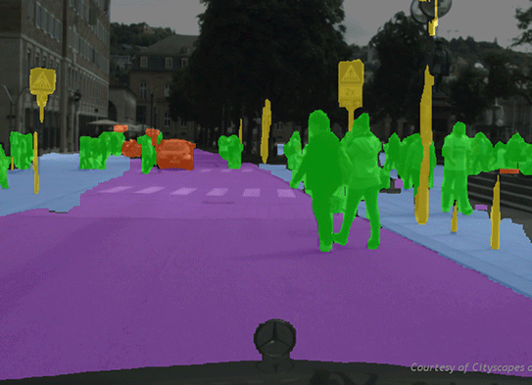
Background
Lidar
Camera
3D Environment
Range Image
Fusion
RGB Image

Slide 4

Related Work
Approaches | Shortages
Joint bilateral filter function | Blurring edges
Anisotropic total generalized variation | Blurring edges
Patch self-similarity for edge guided (KNN + Inference + JBF up sample) | Huge time complexity
MRF with additional constraints | No 2D images segmentation

Slide 5
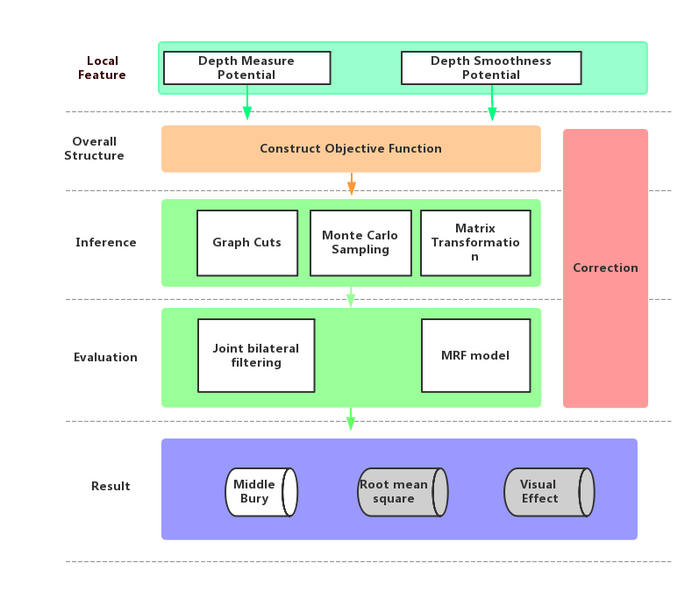
Improved MRF model

Slide 6
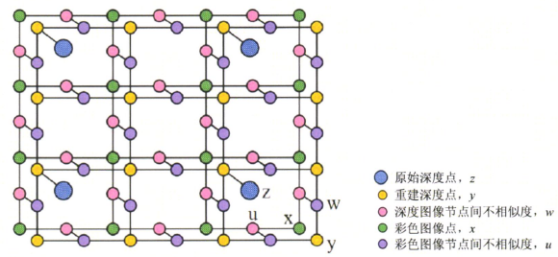


Architecture
The depth measure potential
The depth smoothness prior potential

Slide 7

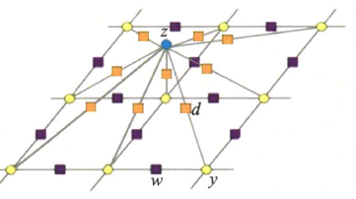
Novelty

Slide 8
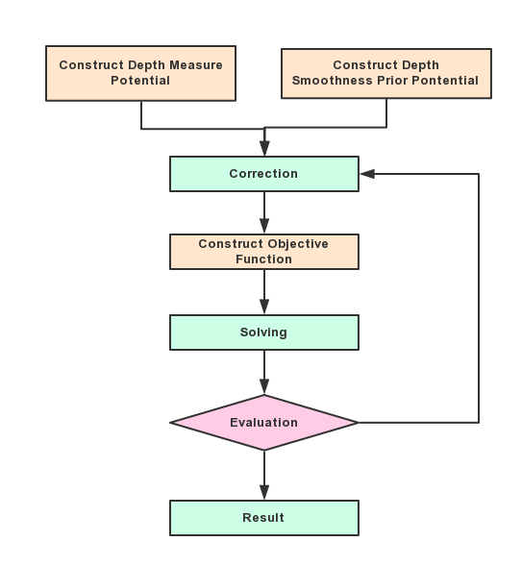
Procedure

Slide 9
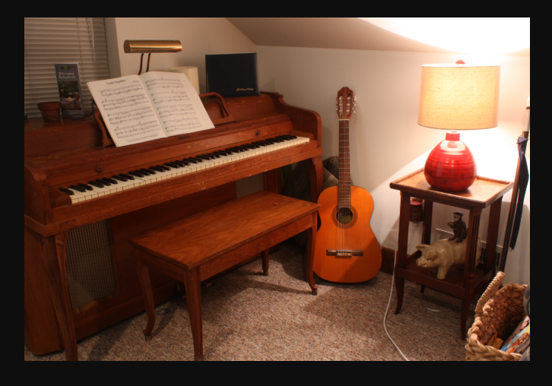
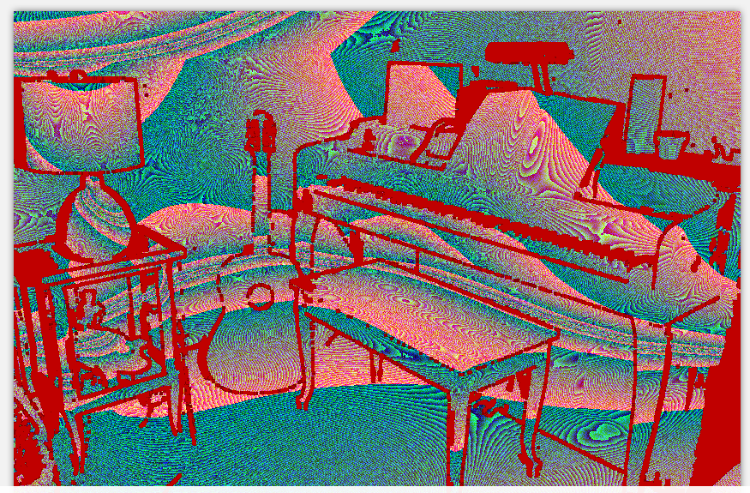
Platform
Data Set Middlebury
Tools
Matlab，SDK，cvkit

Slide 10
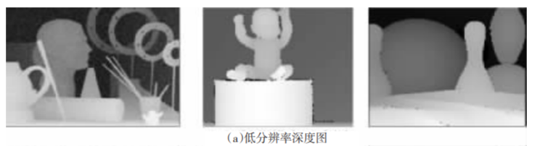
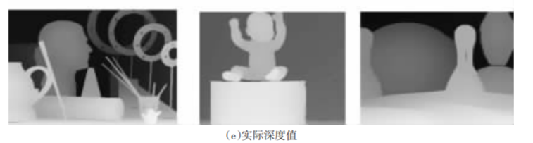
Expected Result

Slide 11
Expected Result
Algorithm | Teddy |  |  | Art |  |  | Laundry
 | 3X | 5X | 10X | 3X | 5X | 10X | 3X | 5X | 10X
Joint bilateral filtering | 2.4 | 2.9 | 4.0 | 5.9 | 7.4 | 11.2 | 2.3 | 2.8 | 4.9
MRF model | 2.5 | 3.2 | 4.5 | 7.0 | 9.2 | 13.0 | 2.3 | 2.7 | 3.8

Slide 12
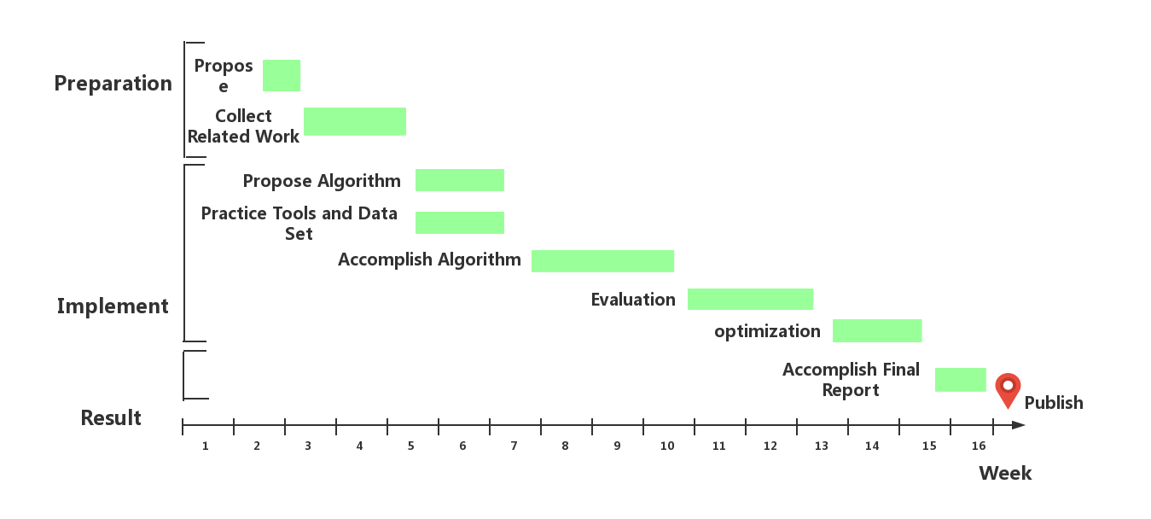
Timeline

Slide 13
Reference
[1] Q. Yang, R. Yang, J. Davis and D. Nister, "Spatial-Depth Super Resolution for Range Images," 2007 IEEE Conference on Computer Vision and Pattern Recognition, Minneapolis, MN, 2007, pp. 1-8.
[2] D. Ferstl, C. Reinbacher, R. Ranftl, M. Ruether and H. Bischof, "Image Guided Depth Upsampling Using Anisotropic Total Generalized Variation," 2013 IEEE International Conference on Computer Vision, Sydney, NSW, 2013, pp. 993-1000.
[3] J. Xie, R. S. Feris and M. Sun, "Edge guided single depth image super resolution," 2014 IEEE International Conference on Image Processing (ICIP), Paris, 2014, pp. 3773-37777.
[4] J. Liu, “彩色图像引导的深度图像增强,” Zhejiang University, Zhejiang, 2014, TP391.41

Slide 14
THANK YOU
延时符

